Slide 1
Implementing Real-Time Analysis with Hadoop in Azure HDInsight 03 | Using Spark for Interactive Data Analysis
Graeme Malcolm | Snr Content Developer, Microsoft

Slide 2
What is Apache Spark?
How is Spark supported in Azure HDInsight?
How do I work with data in Spark?
How do I write Spark programs?
How do I query Spark RDDs using SQL?
What are Notebooks?
What is Spark Streaming?

Slide 3
What is Apache Spark?

Slide 4
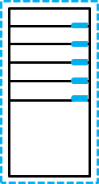

A fast, general purpose computation engine that supports in-memory operations
A unified stack for interactive, streaming, and predictive analysis
Can run in Hadoop clusters

Slide 5
How is Spark supported in Azure HDInsight?

Slide 6
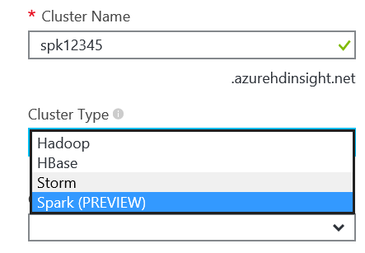
HDInsight supports an Spark cluster type
Choose Cluster Type in the Azure Portal
Specify ClusterType in PowerShell
Creates a Hadoop cluster that includes Spark
Can be provisioned in a virtual network
New-AzureHDInsightCluster -ClusterType Spark

Slide 7
Provisioning a Spark Cluster

Slide 8
How do I work with data in Spark?

Slide 9
The core abstraction for data in Spark is the resilient distributed dataset (RDD)
An RDD represents a collection of items that can be distributed across compute nodes
APIs for working with RDDs are provided for Java, Python, Scala, and (in Spark 1.5.1) R
HDInsight distribution includes Python and Scala shells
 | RDD
ABCDEF | 1234567 | 891011
… | … | …
//Java
import org.apache.spark
class sparkClient
{
…
}
//Scala
val data = …
# Python
def func
d = …

Slide 10
Distributed processing architecture consists of:
A driver program
One or more worker nodes
The driver program uses a spark context to connect to the cluster…
…and uses worker nodes to perform operations on RDDs
Tasks
Executor
Worker Node
Spark Context
Driver Program
Tasks
Executor
Worker Node

Slide 11
To create a Spark Context:
Create a configuration for your cluster and application
Use the configuration to create a context
(Spark shells have one pre-created)
To create an RDD
Load from a source
Text file, JSON, XML, etc.
Parallelize a collection
Cluster URL
cfg = SparkConf().setMaster("local").setAppName("App")
sc = SparkContext(conf = cfg)
Your application name
Path to file
(default text delimiter is newline)
txtRDD = sc.textFile("/data/tweets.txt")
lstRDD = sc.parallelize(["A", "B", "C"])
List

Slide 12
RDD operations include:
Transformations
Create a new RDD by transforming an existing one
Actions
Return results to the driver program or an output file
Spark uses Lazy Evaluation
No execution occurs until an action
RDDs are recomputed with each action
Use persist action to retain in memory
Inline function
msTwts = txtRDD.filter(lambda t: "#ms" in t)
msTwts.count()
msTwts.persist()

Slide 13
Working with Data in Spark

Slide 14
How do I write Spark programs?

Slide 15
Most operations involve passing a function to a transformation or action
Functions can be:
Explicitly declared
Passed inline
Python uses lambda keyword
Scala uses => syntax
Java uses function classes or lambdas (Java 8)
RDD.filter(function)
def containsMSTag(txt):
return "#ms" in txt
msTwts = txtRDD.filter(containsMSTag)
#Python
msTwts = txtRDD.filter(lambda txt: "#ms" in txt)
//Scala
msTwts = txtRDD.filter(txt => txt.contains("#ms")

Slide 16
txt = sc.parallelize(["the owl and the pussycat",
"went to sea"])
Common Transformations:
filter: Creates a filtered RDD
flatMap: Applies a function to each element that returns multiple elements into a new RDD
map: Applies a function to each element that returns an element in a new RDD
reduceByKey: Aggregates values for each key in a key-value pair RDD
{["the owl and the pussycat"], ["went to sea"]}
owlTxt = txt.filter(lambda t: "owl" in t)
{["the owl and the pussycat"]}
words = owlTxt.flatMap(lambda t: t.split(" "))
{["the"], ["owl"], ["and"], ["the"], ["pussycat"]}
kv = words.map(lambda key: (key, 1))
{["the",1], ["owl",1], ["and",1], ["the",1], ["pussycat",1]}
counts = kv.reduceByKey(lambda a, b: a + b)
{["the",2], ["owl",1], ["and",1], ["pussycat",1]}
Notes:
http://spark.apache.org/docs/latest/programming-guide.html#transformations

Slide 17
Common Actions:
reduce: Aggregates the elements of an RDD using a function that takes two arguments
count: Returns the number of elements in the RDD
first: Returns the first element in the RDD
collect: Returns the RDD as an array to the driver program
saveAsTextFile: Saves the RDD as a text file in the specified path
nums = sc.parallelize([1, 2, 3, 4])
{[1], [2], [3], [4]}
nums.reduce(lambda x, y: x + y)
9
nums.count()
4
nums.first()
1
nums.collect()
[1, 2, 3, 4]
nums.saveAsTextFile("/results")
/results/part-00000
Notes:
http://spark.apache.org/docs/latest/programming-guide.html#actions

Slide 18
To create a standalone application:
Create a Python script
Use Maven to build Scala or Java apps
Include code to create Spark context
To run a standalone application:
Use the spark-submit script
sc = SparkContext
...
...
spark-submit c:\myscript.py

Slide 19
Submitting a Standalone Python Script

Slide 20
How do I query Spark RDDs using SQL?

Slide 21
Spark SQL provides a query interface for structured data
DataFrames are used to abstract RDDs and define a schema
There are two API entry points:
HiveContext
SQLContext
Client applications can connect to Spark SQL using JDBC
JDBC
HiveContext
SQLContext
SELECT * FROM …
DataFrame
Col1 | Col2 | Col3
ABCDEF | 1234567 | 891011
 | RDD
ABCDEF | 1234567 | 891011
… | … | …

Slide 22
Infer the schema of an RDD by using Reflection
Specify the schema programmatically
# Python
rows = txtRDD.map(lambda c: Row(name=c[0], email=c[1]))
contacts = sqlContext.inferSchema(rows)
// Scala
case class Contact (name: String, email: String)
val contacts = txtRDD.map(c => Contact(c(0), c(1)).toDF()
# Python
fields = [StructField("name", StringType(), False), StructField("email", StringType(), False)]
schma = StructType(fields)
contacts = sqlContext.createDataFrame(txtRDD, schma)
// Scala
val schemaString = "name,email"
val schma = StructType(schemaString.split(",").map(fName => StructField(fName, StringType, true))
val contacts = sqlContext.createDataFrame(rowRDD, schma)

Slide 23
Using Spark SQL

Slide 24
What are Notebooks?

Slide 25
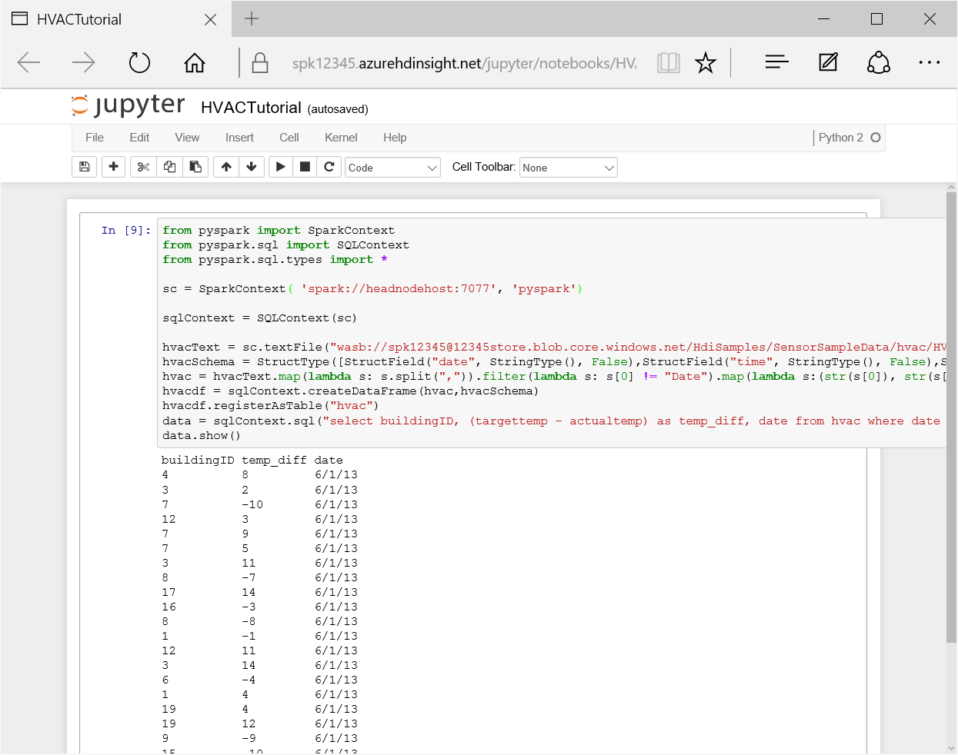
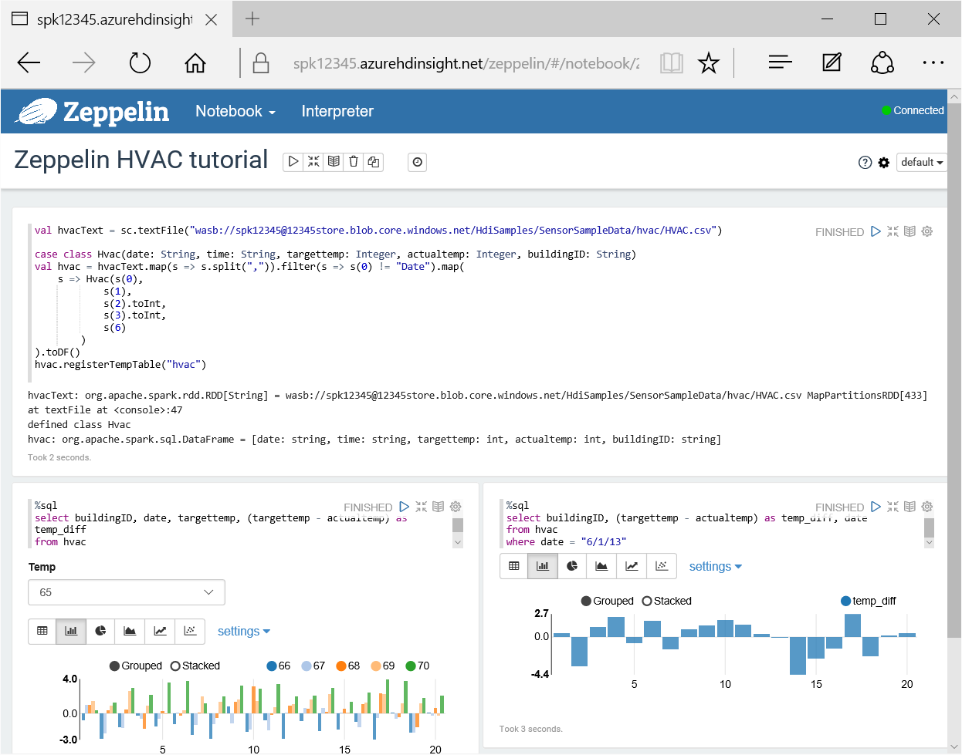
Web-based interactive consoles for
Experimentation
Collaboration
Spark HDInsight clusters include:
Jupyter: Interactive Python
Zeppelin: Interactive Scala and Spark SQL

Slide 26
Using Notebooks

Slide 27
What is Spark Streaming?

Slide 28
Streaming module built on Spark
Data is presented as a sequence of RDDs in discretized streams (DStreams)
Many sources supported:
TCP Socket
File
Kafka
Flume
Azure Event Hubs
RDD
ABC | ABC | ABC
… | … | …
RDD
ABC | ABC | ABC
… | … | …
RDD
ABC | ABC | ABC
… | … | …

Slide 29
Create a streaming context
Create an RDD from a streaming source
Perform operations on the RDD
Regular RDD operations
Streaming-specific operations
Start the streaming context
ssc = StreamingContext(sc, 1)
r = ssc.socketTextStream("localhost", 77)
words = r.flatMap(...)
pairs = words.map(...)
counts = pairs.reduceByKeyAndWindow(...)
ssc.start()
ssc.awaitTermination()

Slide 30
Using Spark Streaming

Slide 31
What is Apache Spark?
How is Spark supported in Azure HDInsight?
How do I work with data in Spark?
How do I write Spark programs?
How do I query Spark RDDs using SQL?
What are Notebooks?
What is Spark Streaming?

